Slide 1
Lecture 21

Slide 2
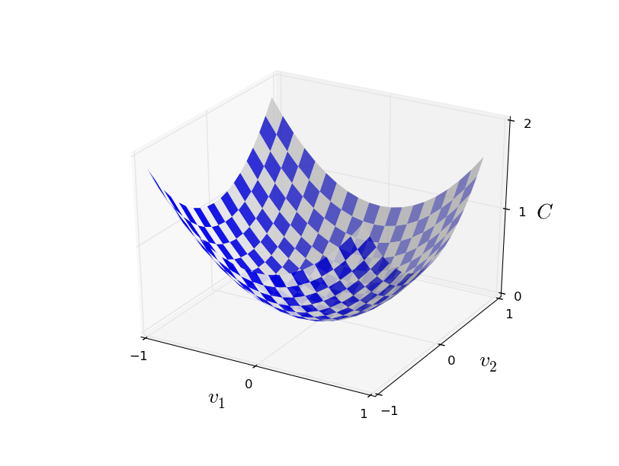
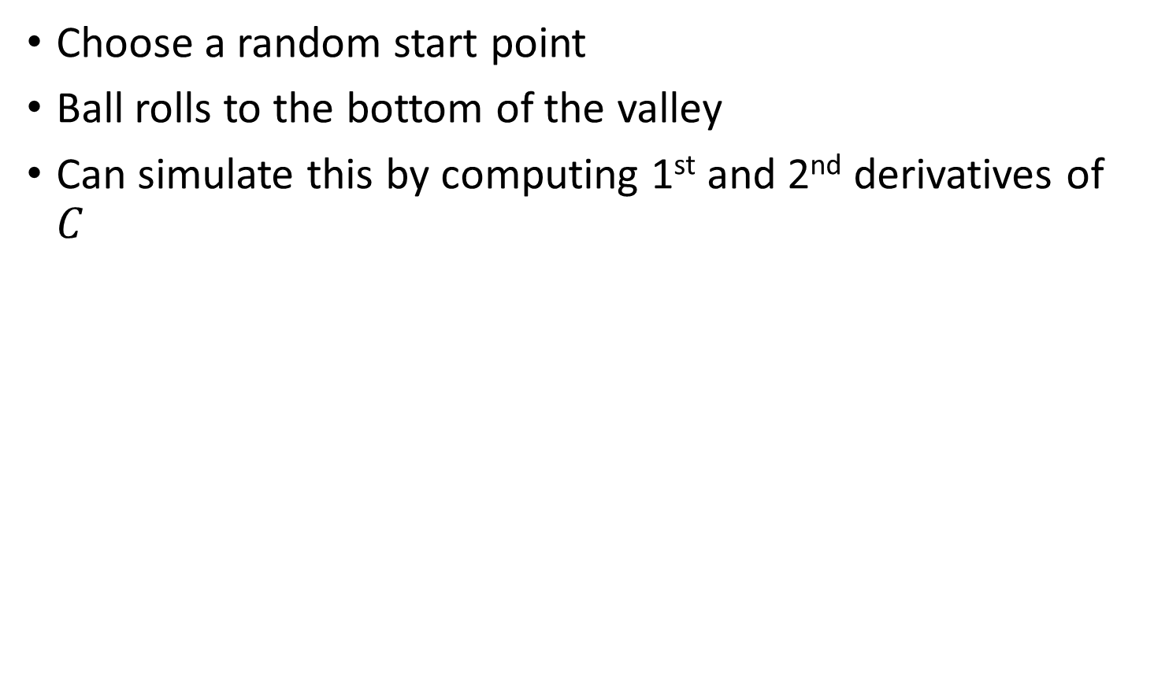
Rolling ball analogy
Choose a random start point
Ball rolls to the bottom of the valley
Can simulate this by computing 1st and 2nd derivatives of $C$
Notes:
These derivatives tell us about the shape of the valley and how the ball should roll

Slide 3
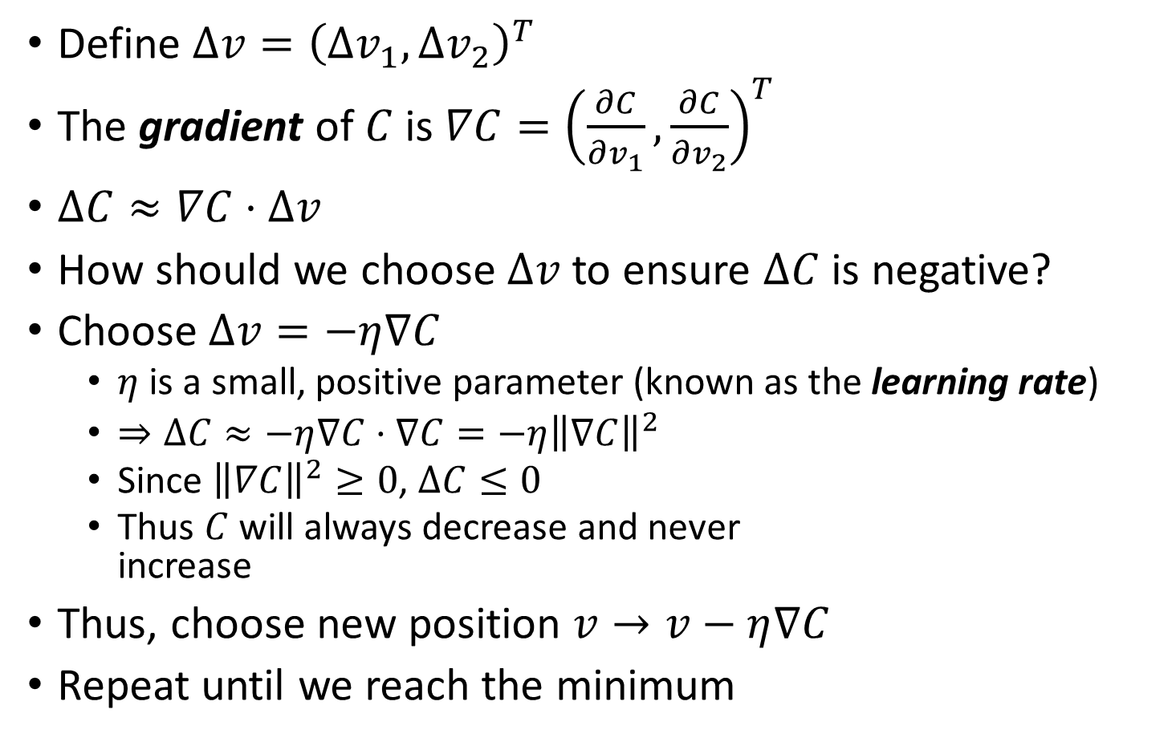
The gradient
Define $Δv={\left(Δv_{1},Δv_{2}\right)}^{T}$
The gradient of $C$ is $∇C={\left(\frac{∂C}{∂v_{1}},\frac{∂C}{∂v_{2}}\right)}^{T}$
$ΔC≈∇C⋅Δv$
How should we choose $Δv$ to ensure $ΔC$ is negative?
Choose $Δv=−η∇C$
$η$ is a small, positive parameter (known as the learning rate)
$⇒ΔC≈−η∇C⋅∇C=−η{\left\|∇C\right\|}^{2}$
Since ${\left\|∇C\right\|}^{2}≥0$, $ΔC≤0$
Thus $C$ will always decrease and never increase
Thus, choose new position $v→v−η∇C$
Repeat until we reach the minimum

Slide 4
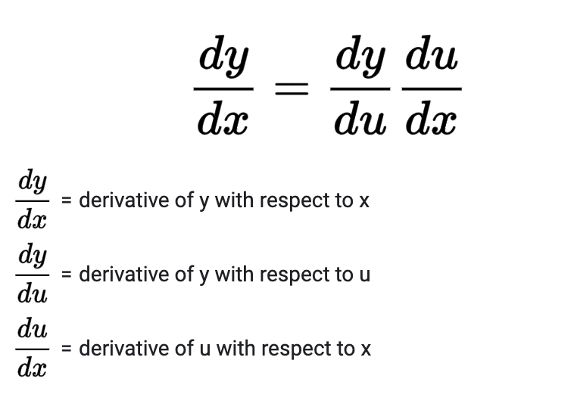
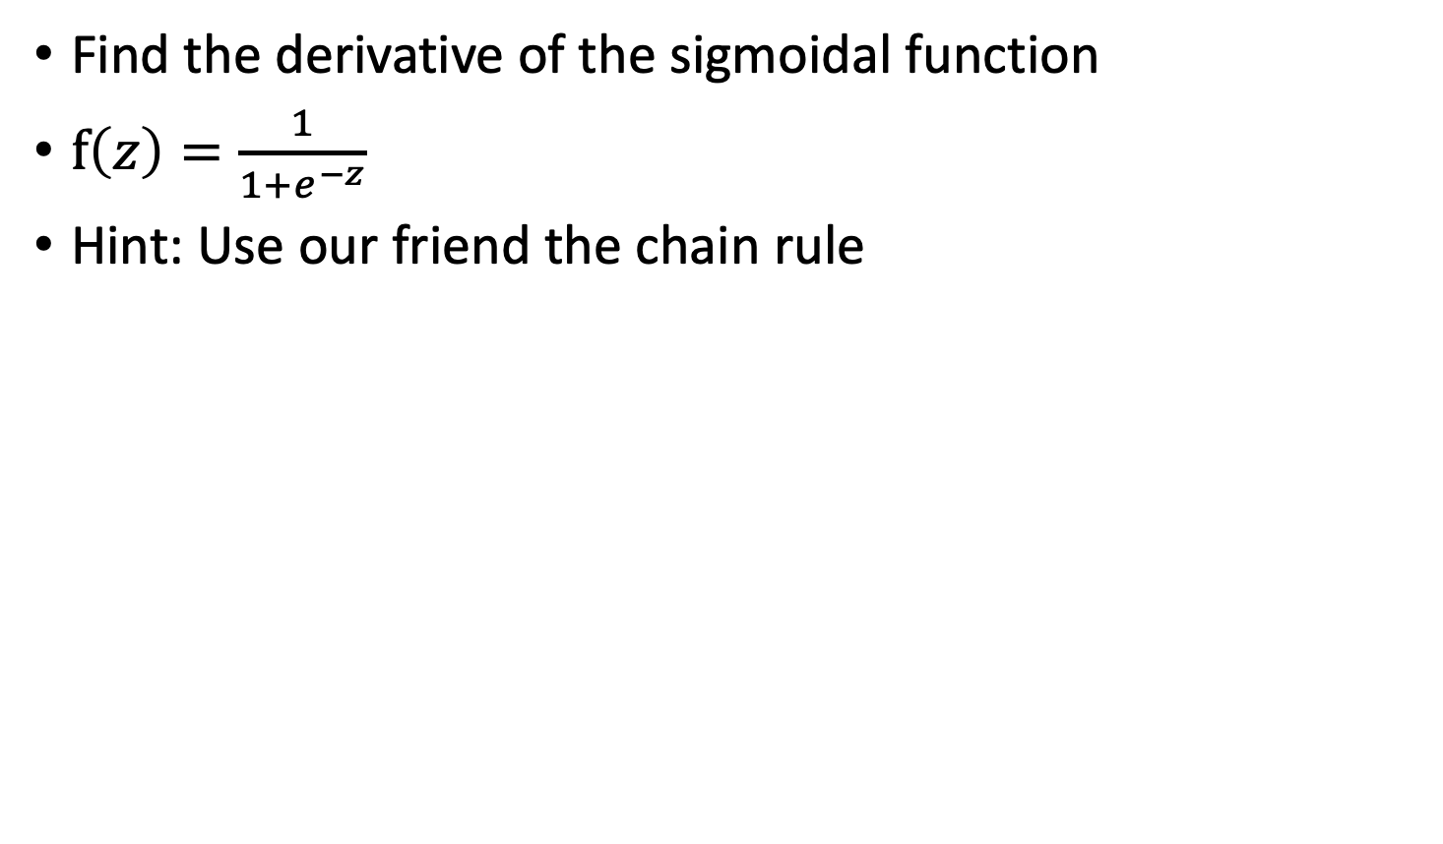
SGD Exercise
Find the derivative of the sigmoidal function
$f\left(z\right)=\frac{1}{1+e^{−z}}$
Hint: Use our friend the chain rule

Slide 5
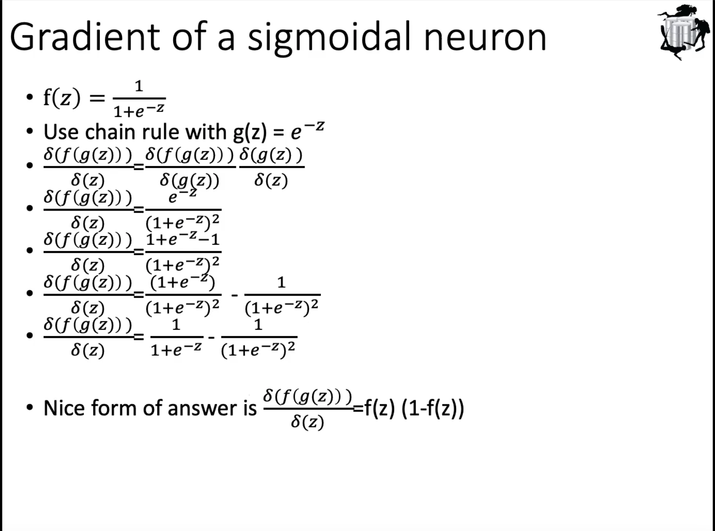

Slide 6

keep info from previous gradient, average them together with gradient from current iteration, memorize current gradient descent, so gradient doesn’t flip too much
second order info from hash
when get closer to solution, does increase/decrease learning rate help?
intuition: decrease
but tricky: gradient get closer to 0, decreasing learning rate, maybe slow down the convergence

Slide 7
Backpropagation history
Introduced in 1970’s
Unappreciated until 1986 paper by David Rumelhart, Geoffrey Hinton, and Ronald Williams
Described several neural networks where backpropagation works far faster than earlier learning approaches
Today, backpropagation is the “workhorse” of learning neural networks

Slide 8
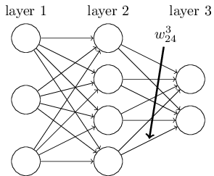
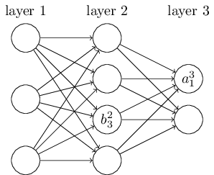
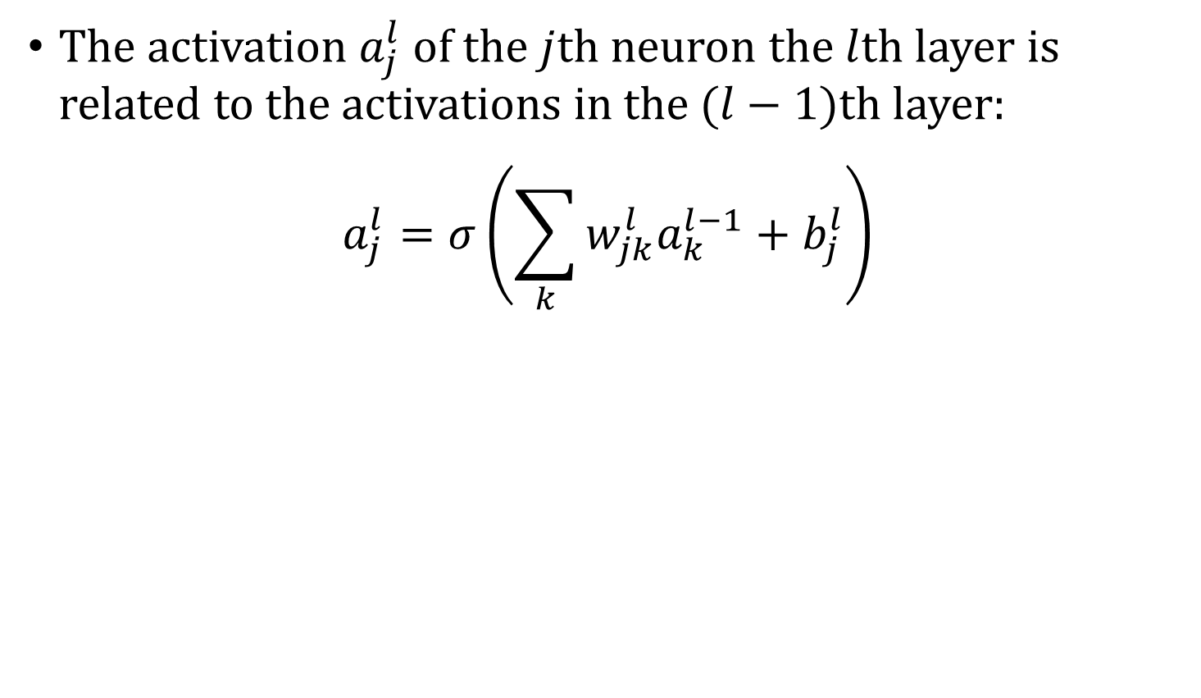
Forward propagation
The activation $a_{j}^{l}$ of the $j$th neuron the $l$th layer is related to the activations in the $(l−1)$th layer:
$$a_{j}^{l}=σ\left(\sum_{k}{w_{jk}^{l}a_{k}^{l−1}+b_{j}^{l}}\right)$$
Notes:
Note that the sum is over all k neurons in the (l-1)th layer. Write on board, the example of $a_{1}^{3}$ here. Write $a_{1}^{3}=σ(\sum_{k=1}^{4}{w_{1k}^{3}a_{k}^{2}+b_{1}^{3})}$

Slide 9
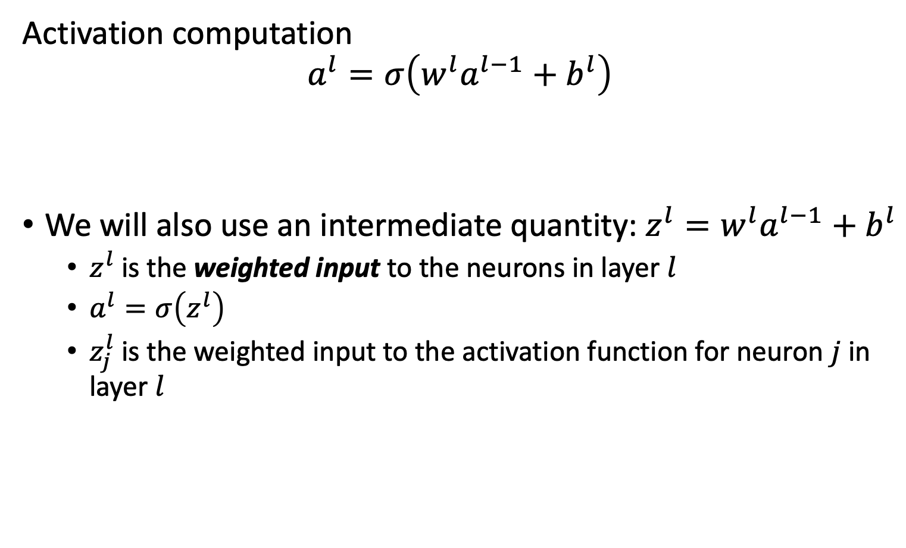
Matrix multiplication for computing activations
Activation computation
$$a^{l}=σ\left(w^{l}a^{l−1}+b^{l}\right)$$
We will also use an intermediate quantity: $z^{l}=w^{l}a^{l−1}+b^{l}$
$z^{l}$ is the weighted input to the neurons in layer $l$
$a^{l}=σ\left(z^{l}\right)$
$z_{j}^{l}$ is the weighted input to the activation function for neuron $j$ in layer $l$

Slide 10
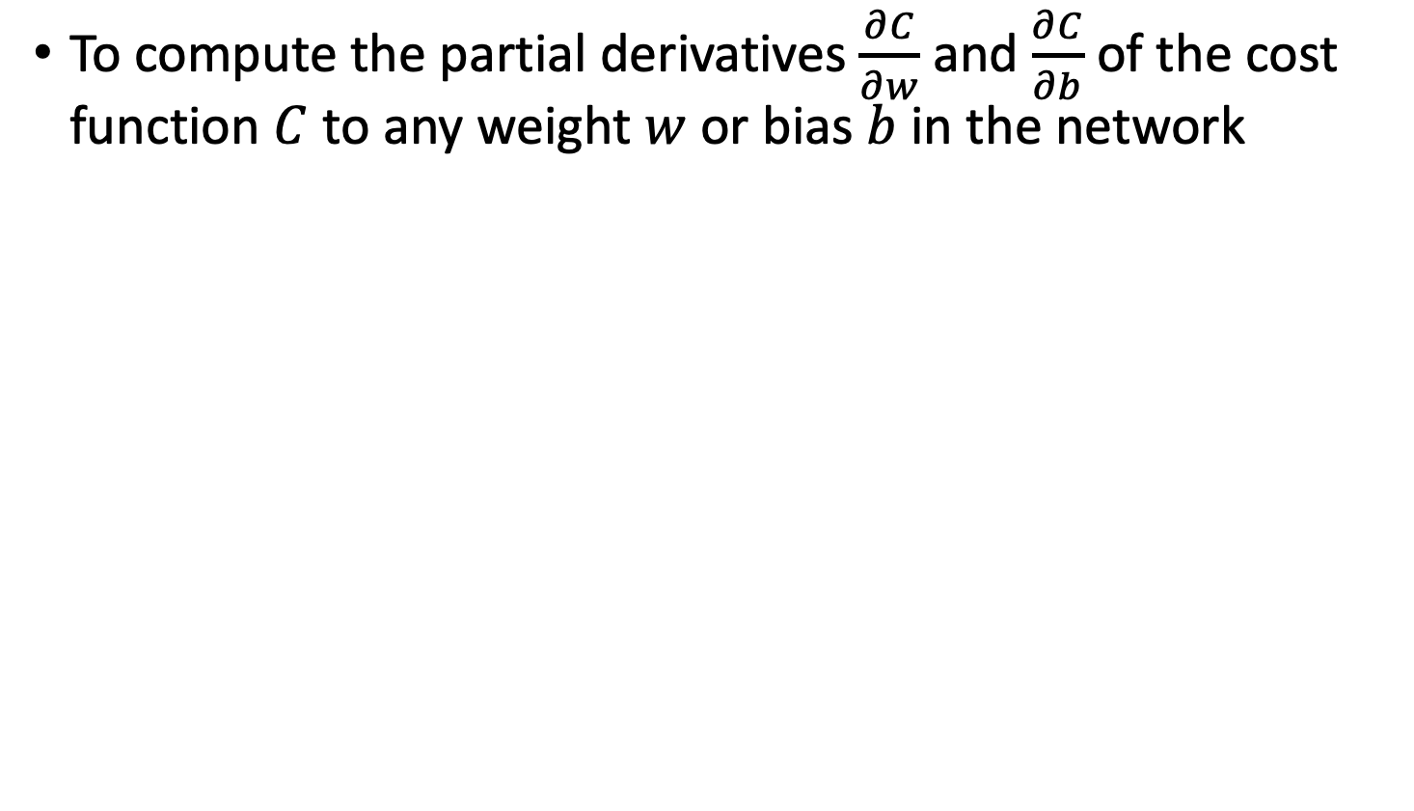
Goal of Backpropagation
To compute the partial derivatives $\frac{∂C}{∂w}$ and $\frac{∂C}{∂b}$ of the cost function $C$ to any weight $w$ or bias $b$ in the network

Slide 11
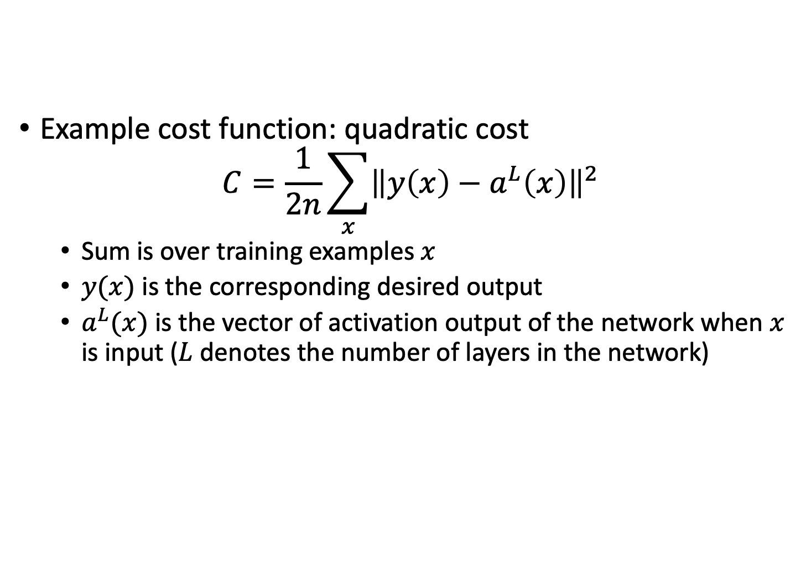
Cost function
Example cost function: quadratic cost
$$C=\frac{1}{2n}\sum_{x}{{\left\|y\left(x\right)−a^{L}\left(x\right)\right\|}^{2}}$$
Sum is over training examples $x$
$y(x)$ is the corresponding desired output
$a^{L}(x)$ is the vector of activation output of the network when $x$ is input ($L$ denotes the number of layers in the network)

Slide 12
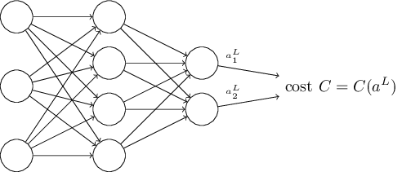
Cost function
Cost can be written as a function of the neural network outputs
Also cost can be written as an average cost of batch training samples
Notes:
Go slow here. Recall that C=C_x and that we’re assuming that x and therefore y are fixed.

Slide 13
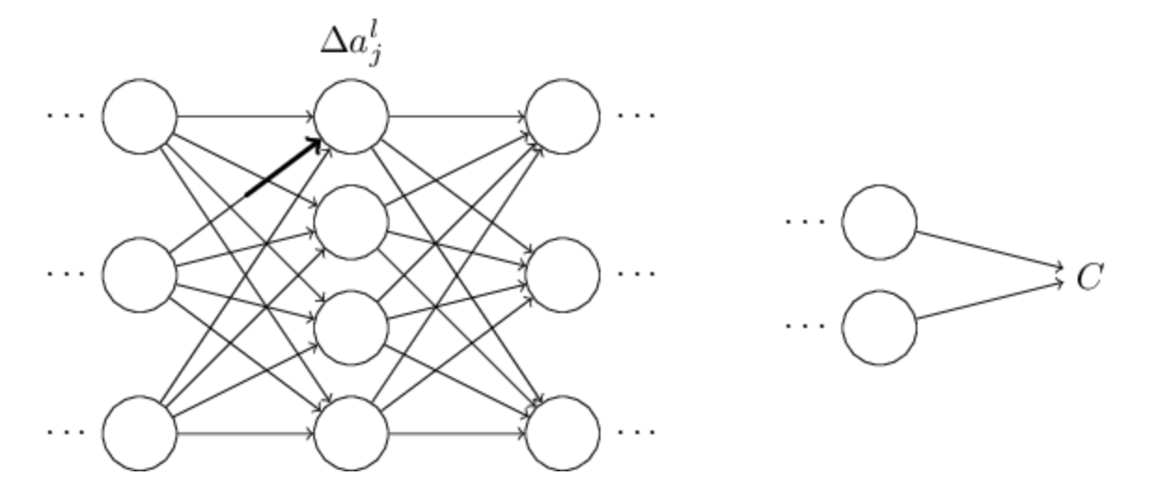
Backpropagation: Error forward
Suppose you made a small change to a weight
Causes a change in the activation of the output neuron

Slide 14
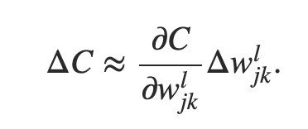
Change propagates…
Causes a change in all the activations in the next layer
Then moves to the next layer, next layer …to the output and then the cost function

Slide 15
Tracking the change
This suggests that if we track how a weight change propagates to change the cost function then we can compute the gradient of the weight with respect to the cost function
Lets try it!

Slide 16
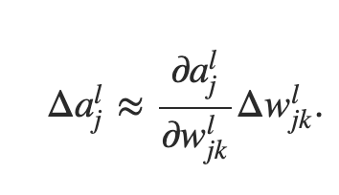
Weight → activation
Change in weight causes change in following activation

Slide 17
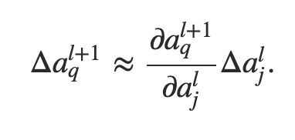
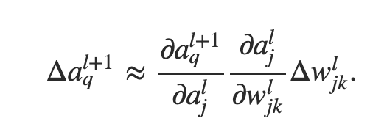
Activation→next layer Activation

Slide 18
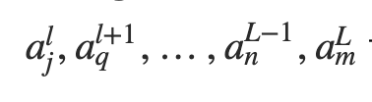
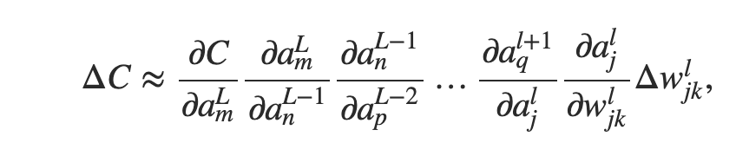
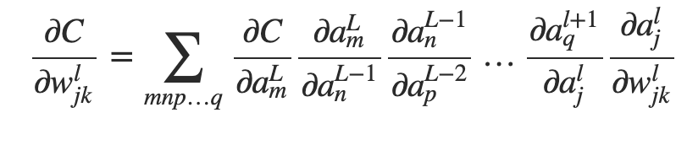
Next activation→Cost
Path through layers:
Summing over all paths:
Already computed proceeding backwards

Slide 19
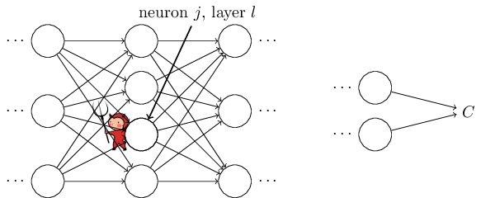
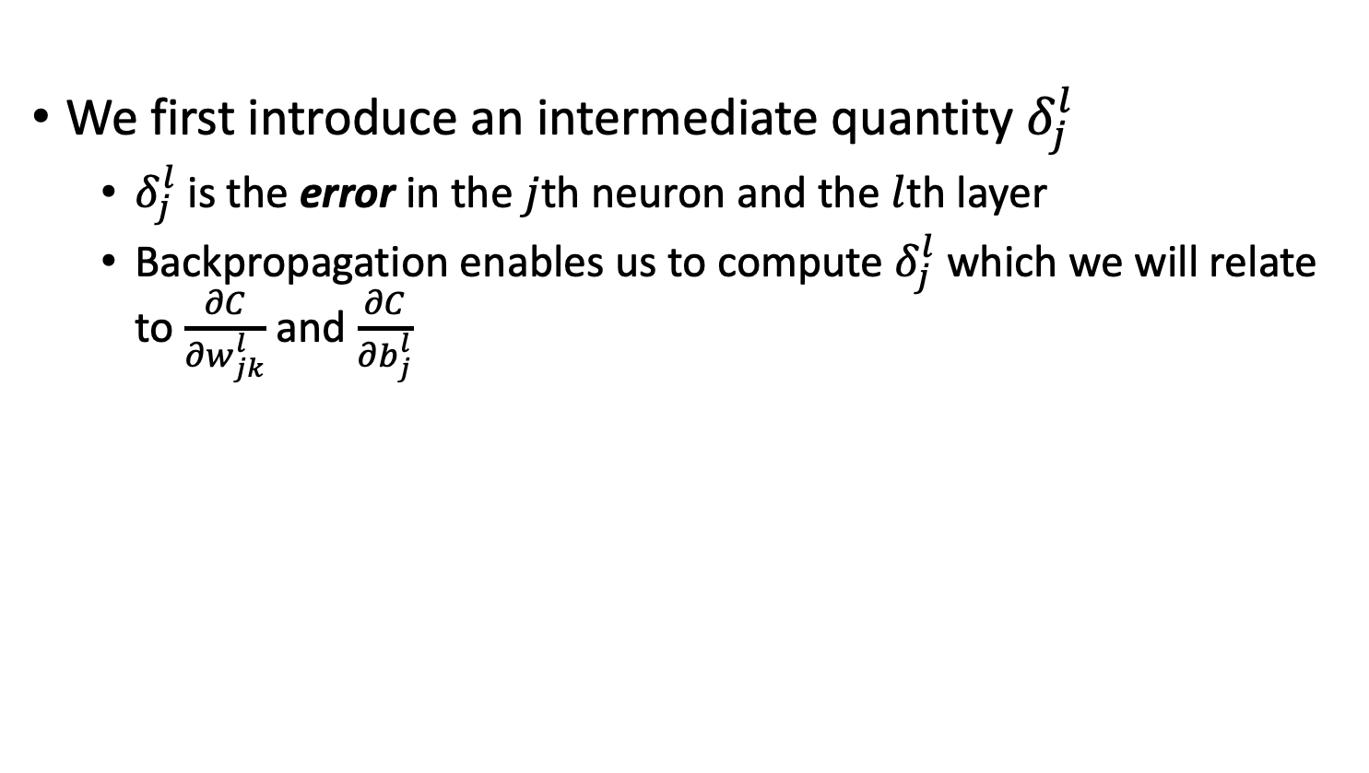
Preliminary: Error at the node
We first introduce an intermediate quantity $δ_{j}^{l}$
$δ_{j}^{l}$ is the error in the $j$th neuron and the $l$th layer
Backpropagation enables us to compute $δ_{j}^{l}$ which we will relate to $\frac{∂C}{∂w_{jk}^{l}}$ and $\frac{∂C}{∂b_{j}^{l}}$

Slide 20
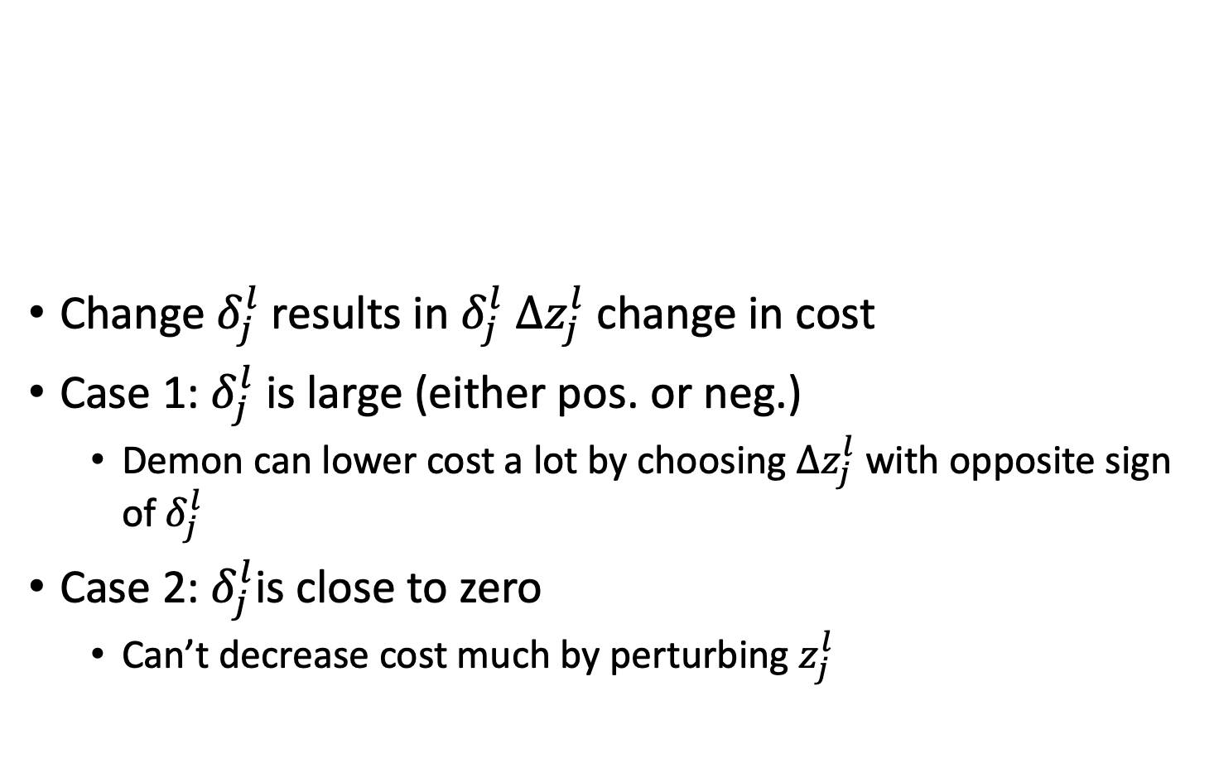
Error at the node
Change $δ_{j}^{l}$results in $δ_{j}^{l} Δz_{j}^{l}$ change in cost
Case 1: $δ_{j}^{l}$is large (either pos. or neg.)
Demon can lower cost a lot by choosing $Δz_{j}^{l}$ with opposite sign of $δ_{j}^{l}$
Case 2: $δ_{j}^{l}$is close to zero
Can’t decrease cost much by perturbing $z_{j}^{l}$
Notes:
Suppose the demon is good and wants to make the cost smaller

Slide 21
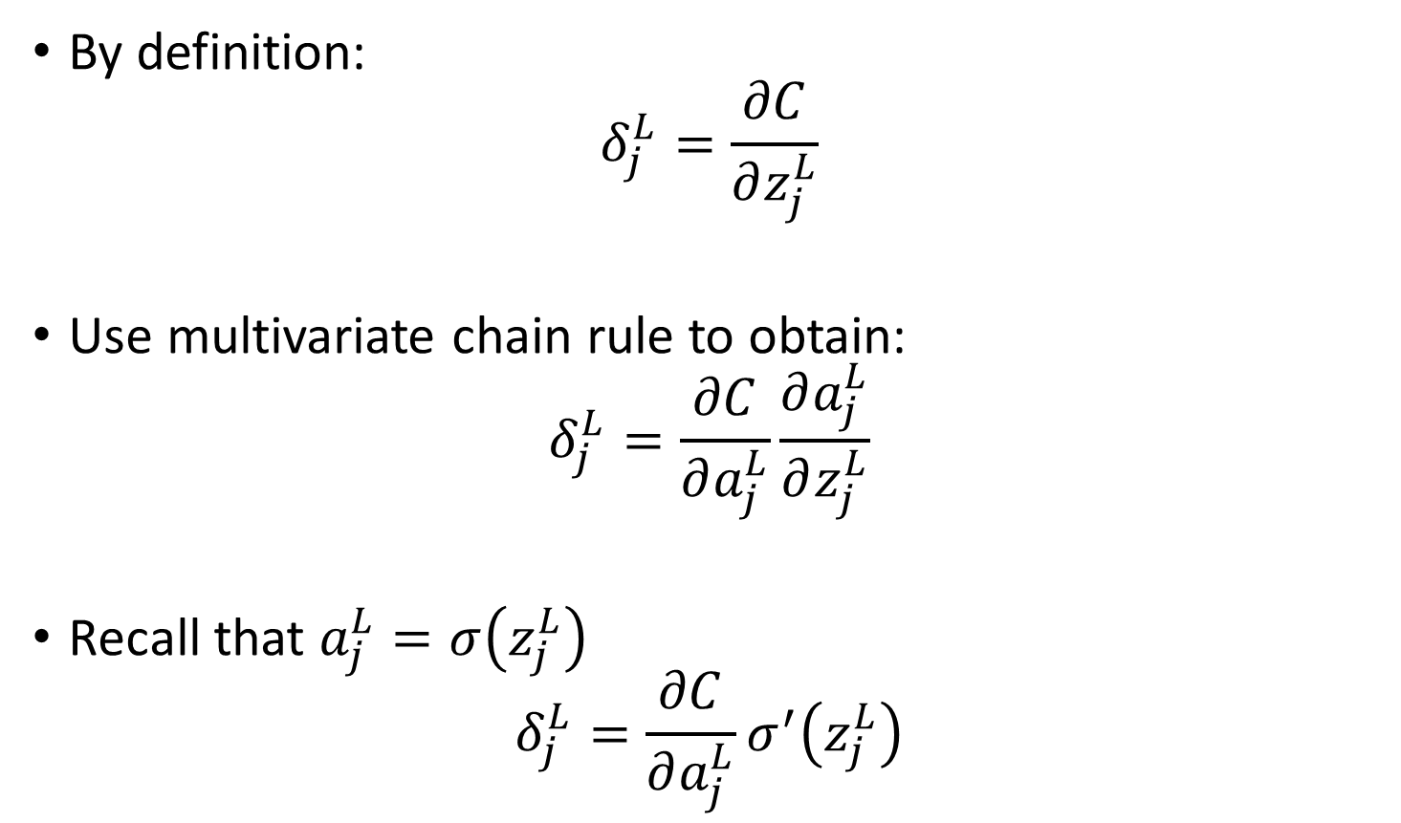
1st Equation Error at the Output
By definition:
$$δ_{j}^{L}=\frac{∂C}{∂z_{j}^{L}}$$
Use multivariate chain rule to obtain:
$$δ_{j}^{L}=\frac{∂C}{∂a_{j}^{L}}\frac{∂a_{j}^{L}}{∂z_{j}^{L}}$$
Recall that $a_{j}^{L}=σ\left(z_{j}^{L}\right)$
$$δ_{j}^{L}=\frac{∂C}{∂a_{j}^{L}}σ^{′}\left(z_{j}^{L}\right)$$
Notes:
Do details on board

Slide 22
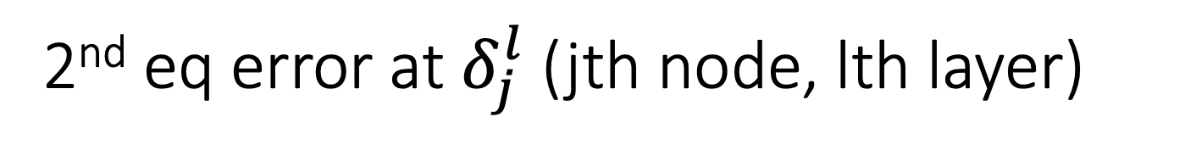
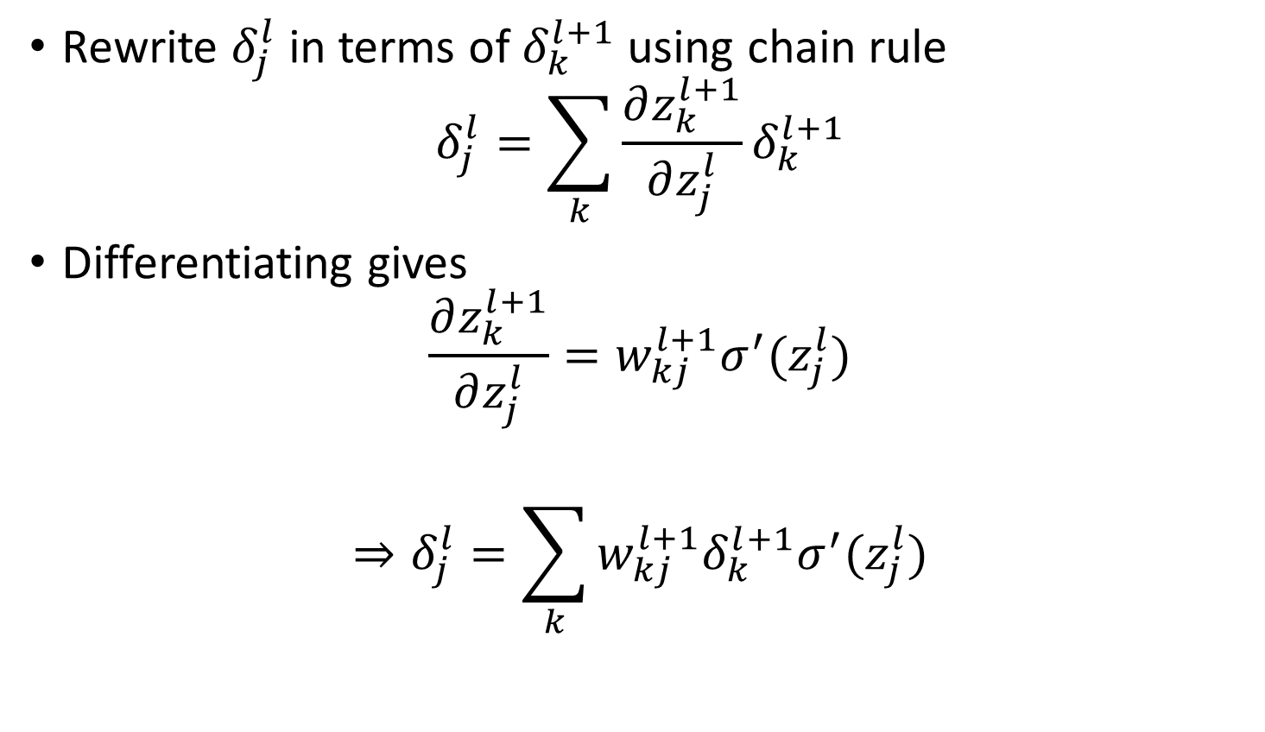
2nd eq error at $δ_{j}^{l}$ (jth node, lth layer)
Rewrite $δ_{j}^{l}$ in terms of $δ_{k}^{l+1}$ using chain rule
$$δ_{j}^{l}=\sum_{k}{\frac{∂z_{k}^{l+1}}{∂z_{j}^{l}}δ_{k}^{l+1}}$$
Differentiating gives
$$\frac{∂z_{k}^{l+1}}{∂z_{j}^{l}}=w_{kj}^{l+1}σ^{′}(z_{j}^{l})$$
$$⇒δ_{j}^{l}=\sum_{k}{w_{kj}^{l+1}δ_{k}^{l+1}σ^{′}(z_{j}^{l})}$$

Slide 23
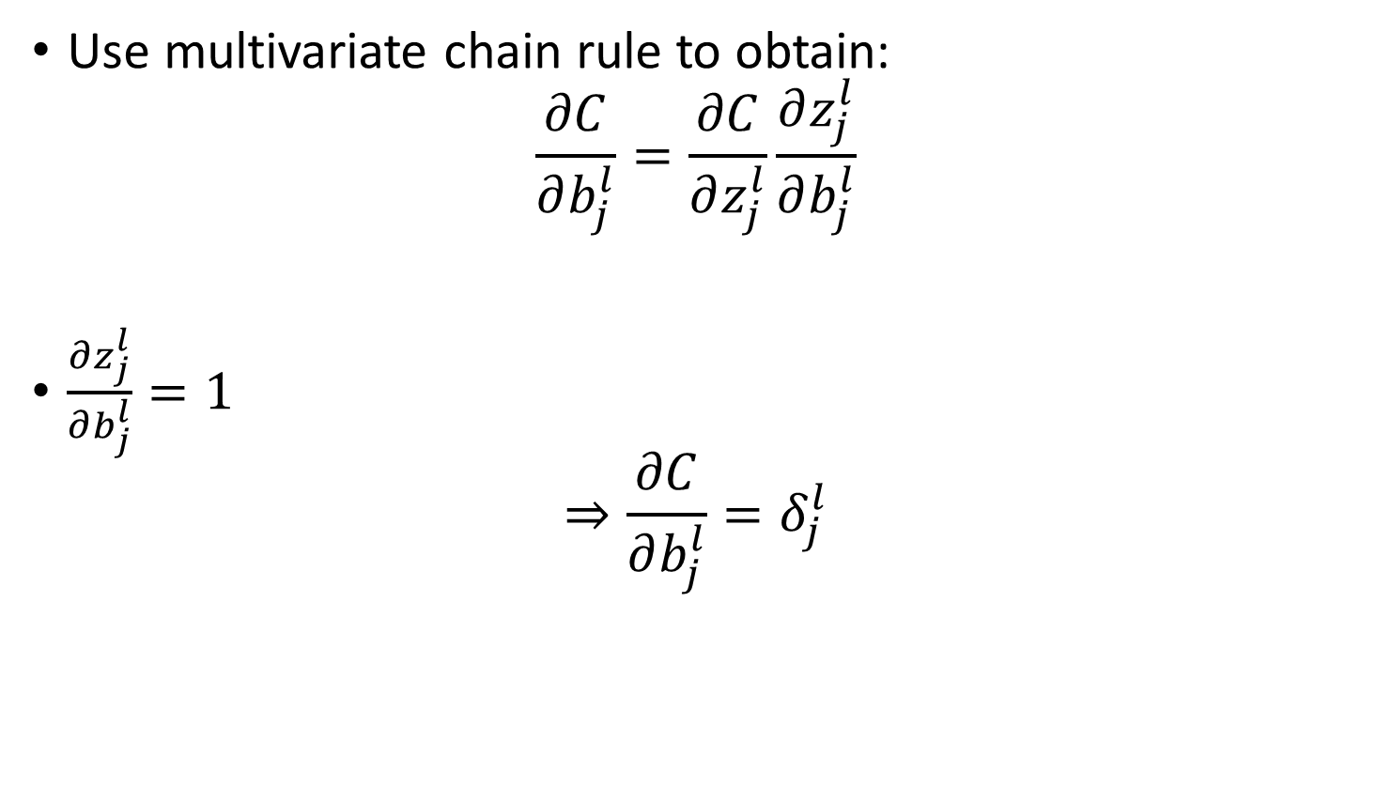
3rd equation error of a bias
Use multivariate chain rule to obtain:
$$\frac{∂C}{∂b_{j}^{l}}=\frac{∂C}{∂z_{j}^{l}}\frac{∂z_{j}^{l}}{∂b_{j}^{l}}$$
$\frac{∂z_{j}^{l}}{∂b_{j}^{l}}=1$
$$⇒\frac{∂C}{∂b_{j}^{l}}=δ_{j}^{l}$$

Slide 24
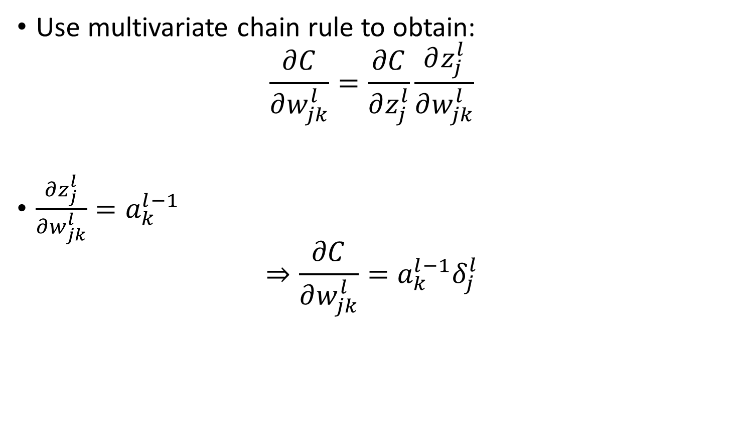
4th equation error of weight
Use multivariate chain rule to obtain:
$$\frac{∂C}{∂w_{jk}^{l}}=\frac{∂C}{∂z_{j}^{l}}\frac{∂z_{j}^{l}}{∂w_{jk}^{l}}$$
$\frac{∂z_{j}^{l}}{∂w_{jk}^{l}}=a_{k}^{l−1}$
$$⇒\frac{∂C}{∂w_{jk}^{l}}=a_{k}^{l−1}δ_{j}^{l}$$
Notes:
Ask students to suggest how they would prove it

Slide 25
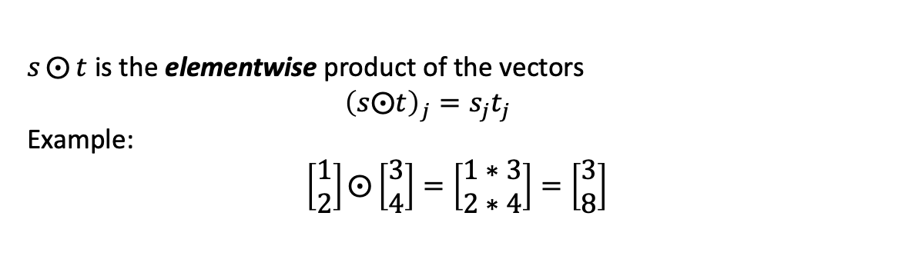
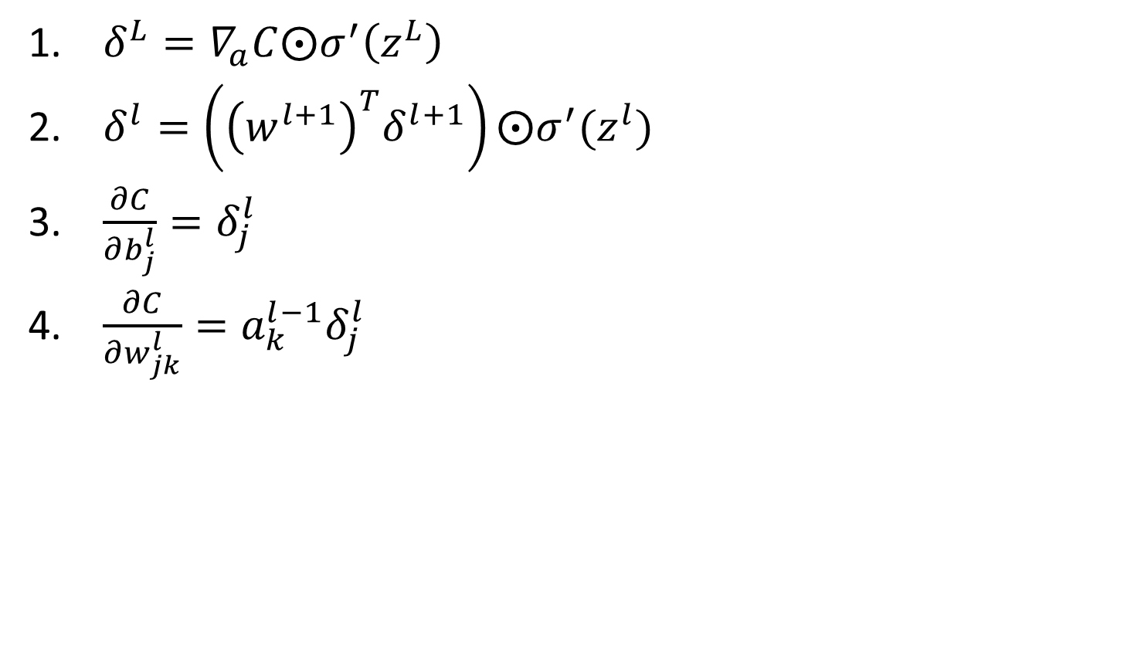
The 4 fundamental equations of backpropagation
$δ^{L}=∇_{a}C⨀σ^{′}\left(z^{L}\right)$
$δ^{l}=\left({\left(w^{l+1}\right)}^{T}δ^{l+1}\right)⨀σ^{′}(z^{l})$
$\frac{∂C}{∂b_{j}^{l}}=δ_{j}^{l}$
$\frac{∂C}{∂w_{jk}^{l}}=a_{k}^{l−1}δ_{j}^{l}$
$s⨀{t}$ is the elementwise product of the vectors
$${\left(s⨀t\right)}_{j}=s_{j}t_{j}$$
Example:
$$\left[\begin{matrix}1 \\ 2\end{matrix}\right]⨀\left[\begin{matrix}3 \\ 4\end{matrix}\right]=\left[\begin{matrix}1∗3 \\ 2∗4\end{matrix}\right]=\left[\begin{matrix}3 \\ 8\end{matrix}\right]$$

Slide 26
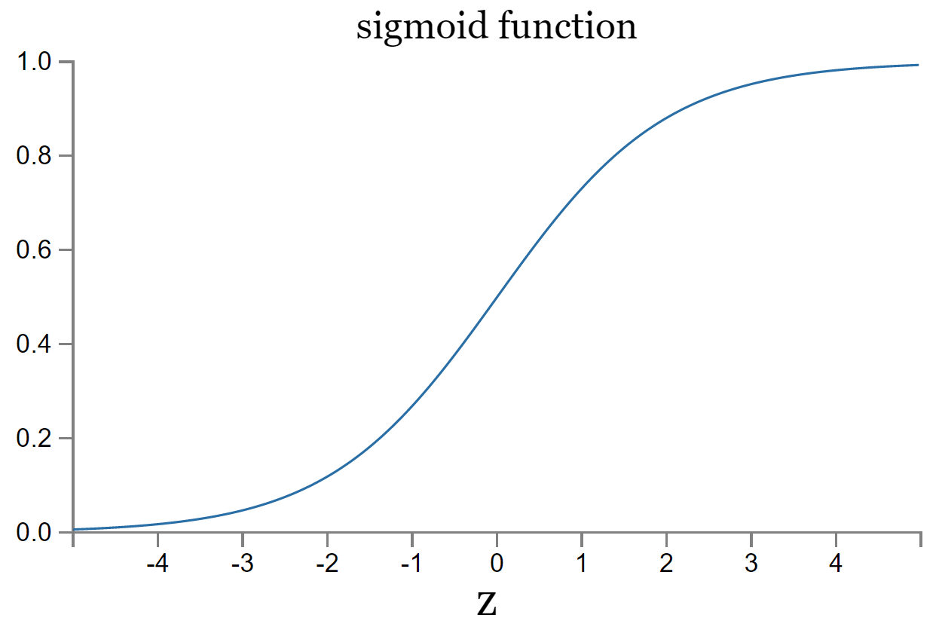
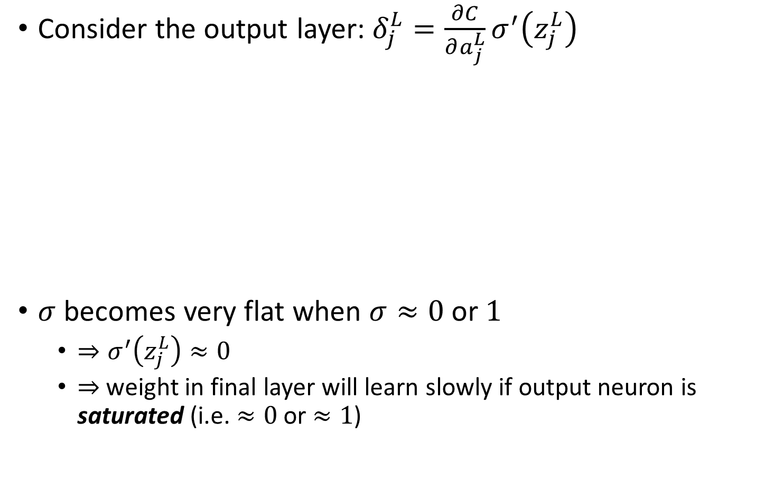
Insights from the 4 fundamental equations
Consider the output layer: $δ_{j}^{L}=\frac{∂C}{∂a_{j}^{L}}σ^{′}\left(z_{j}^{L}\right)$
$σ$ becomes very flat when $σ≈0$ or $1$
$⇒σ^{′}\left(z_{j}^{L}\right)≈0$
$⇒$ weight in final layer will learn slowly if output neuron is saturated (i.e. $≈0$ or $≈1$)

Slide 27
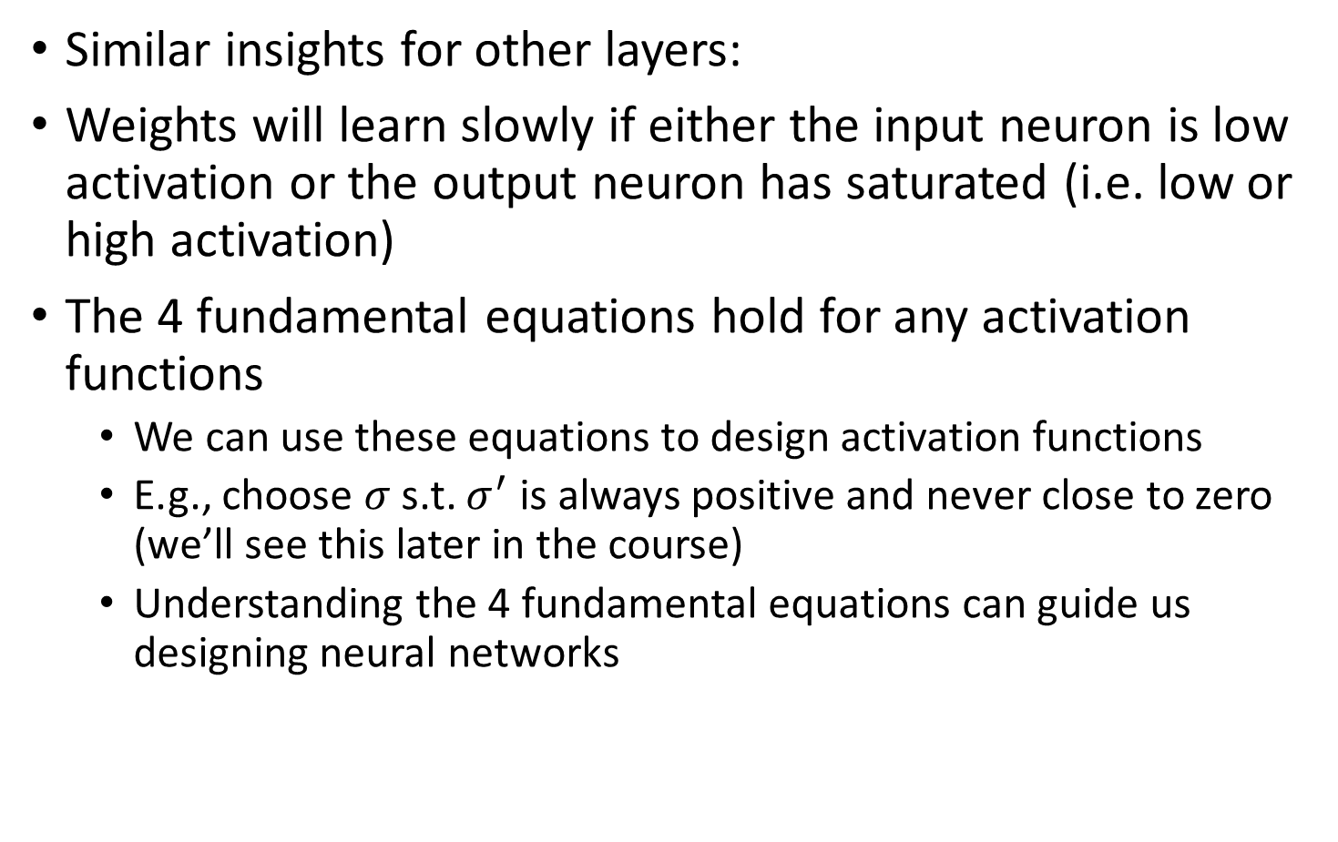
Insights from the 4 fundamental equations
Similar insights for other layers:
Weights will learn slowly if either the input neuron is low activation or the output neuron has saturated (i.e. low or high activation)
The 4 fundamental equations hold for any activation functions
We can use these equations to design activation functions
E.g., choose $σ$ s.t. $σ^{′}$ is always positive and never close to zero (we’ll see this later in the course)
Understanding the 4 fundamental equations can guide us designing neural networks

Slide 28
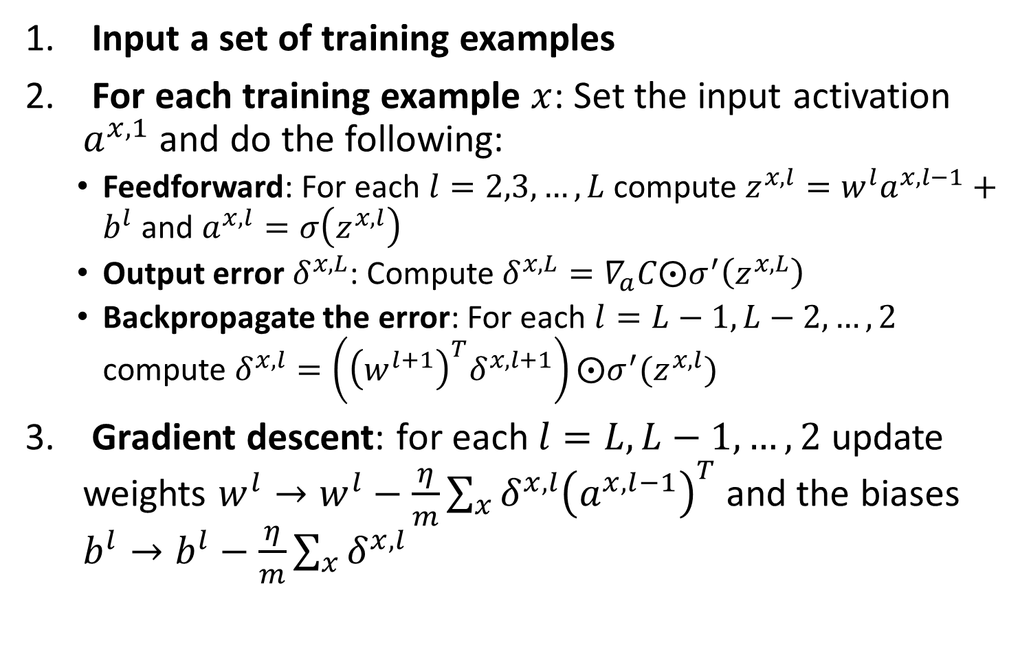
Backpropagation with SGD
Input a set of training examples
For each training example $x$: Set the input activation $a^{x,1}$ and do the following:
Feedforward: For each $l=2,3,…,L$ compute $z^{x,l}=w^{l}a^{x,l−1}+b^{l}$ and $a^{x,l}=σ\left(z^{x,l}\right)$
Output error $δ^{x,L}$: Compute $δ^{x,L}=∇_{a}C⨀σ^{′}\left(z^{x,L}\right)$
Backpropagate the error: For each $l=L−1,L−2,…,2$ compute $δ^{x,l}=\left({\left(w^{l+1}\right)}^{T}δ^{x,l+1}\right)⨀σ^{′}(z^{x,l})$
Gradient descent: for each $l=L,L−1,…,2$ update weights $w^{l}→w^{l}−\frac{η}{m}\sum_{x}{δ^{x,l}{\left(a^{x,l−1}\right)}^{T}}$ and the biases $b^{l}→b^{l}−\frac{η}{m}\sum_{x}{δ^{x,l}}$
Notes:
Note that to do this, we also need an outer loop that generates mini batches and an outer loop for multiple epochs of training which are omitted here

Slide 29
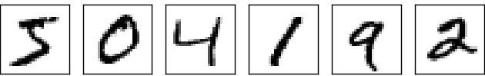
Excercise
How would you code an algorithm to recognize different digits?

Slide 30
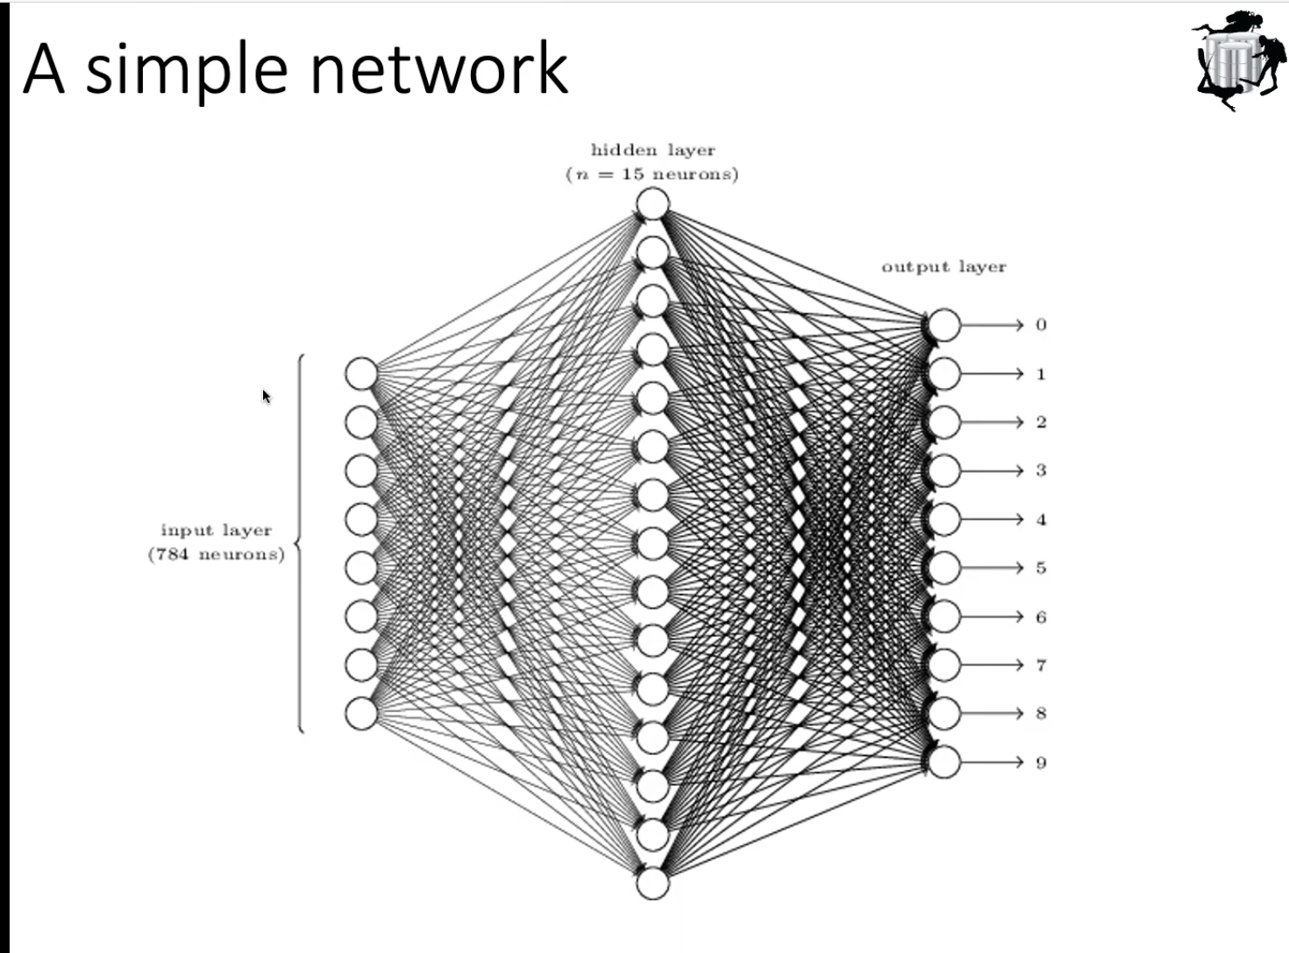
an 28 x 28 image

Slide 31
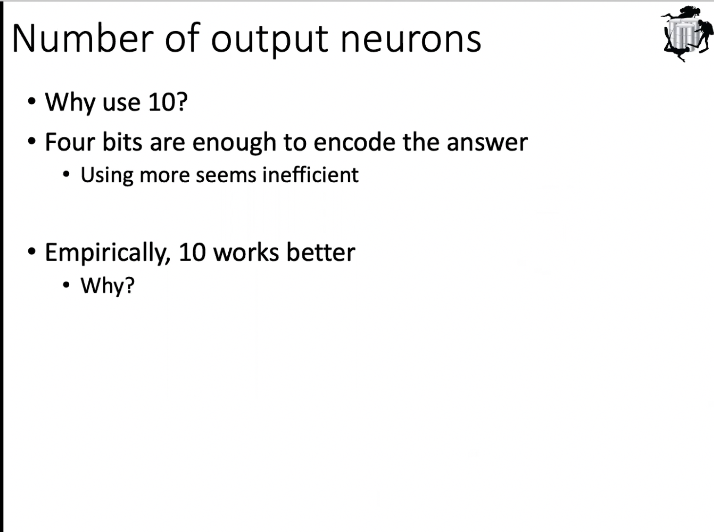

Slide 32
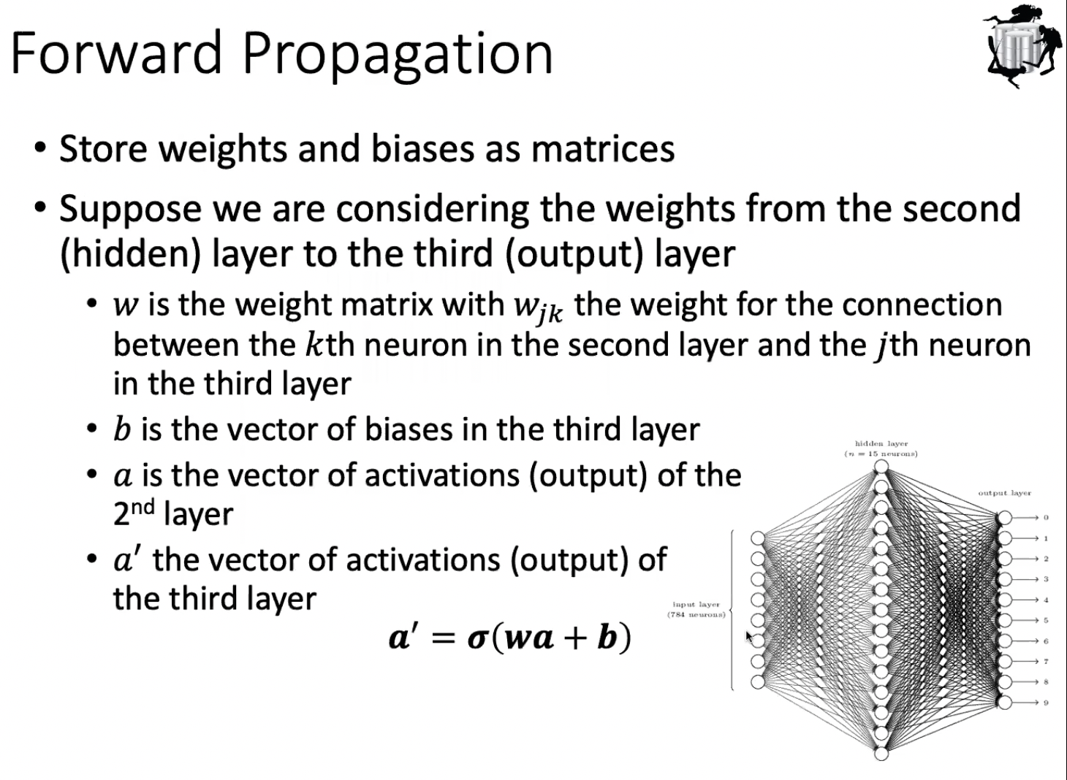

Slide 33
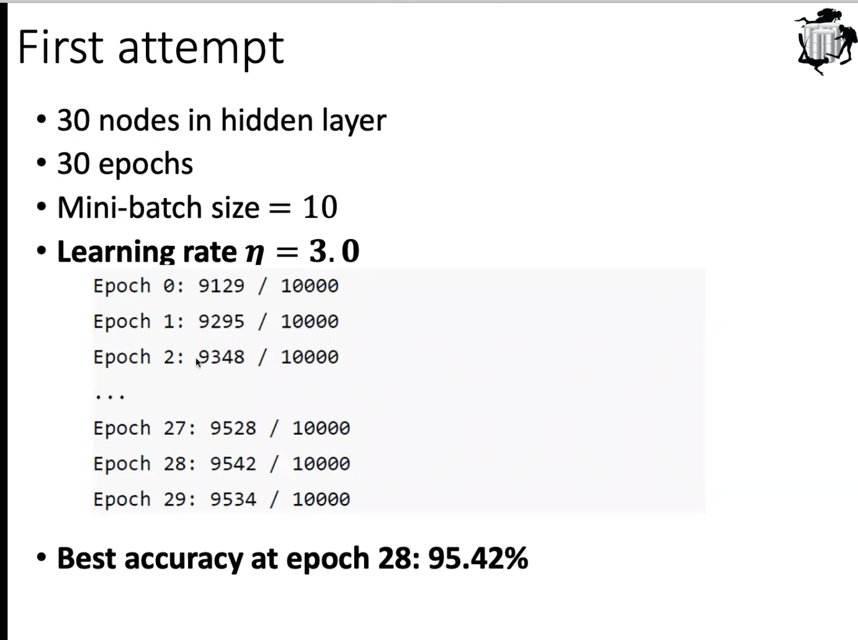

Slide 34
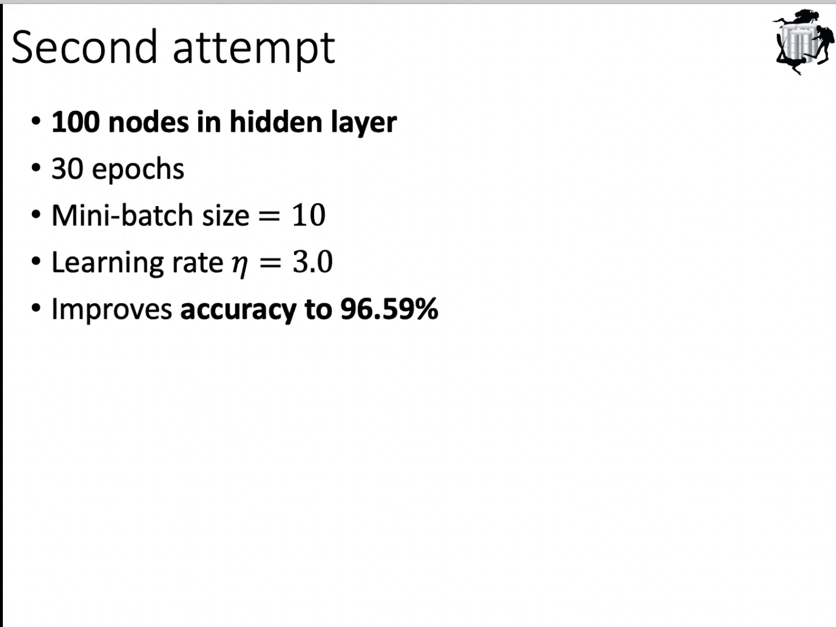

Slide 35
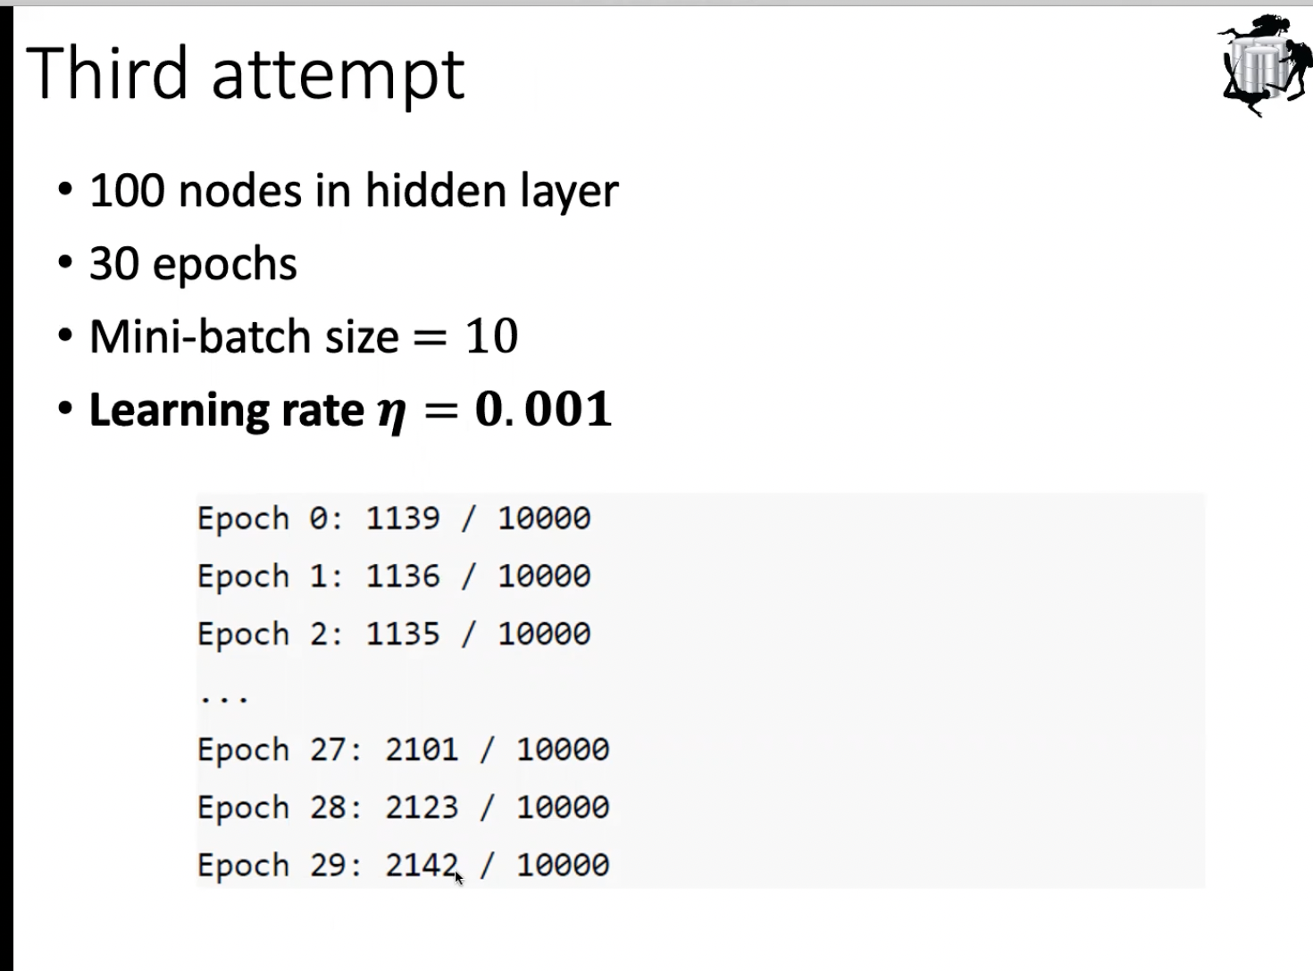

Slide 36
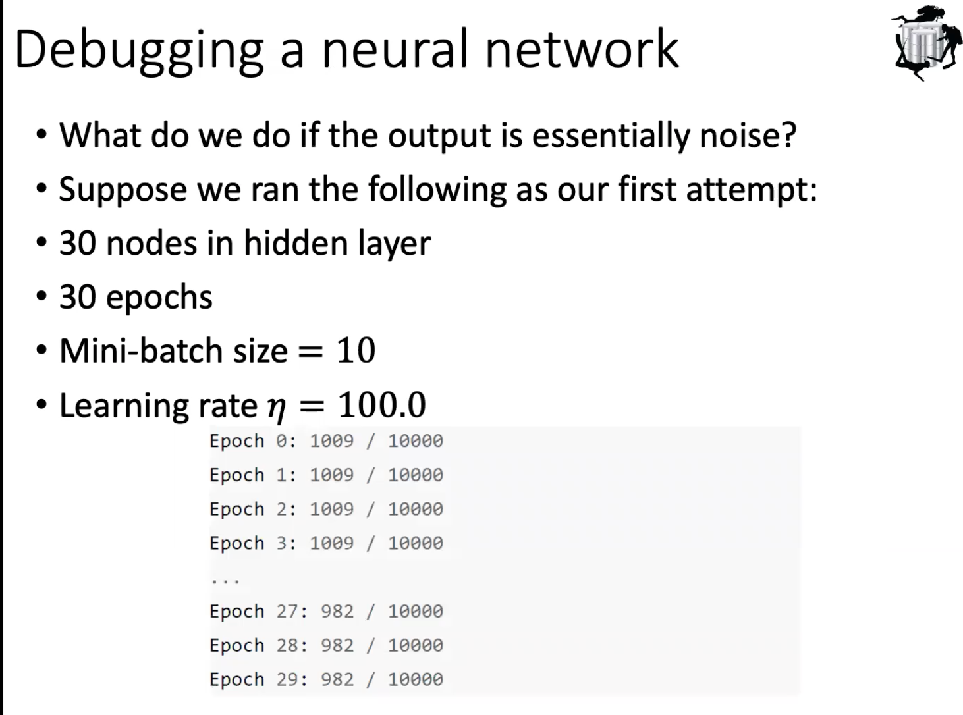
if learning rate is too high, we will see osilating behavior

Slide 37
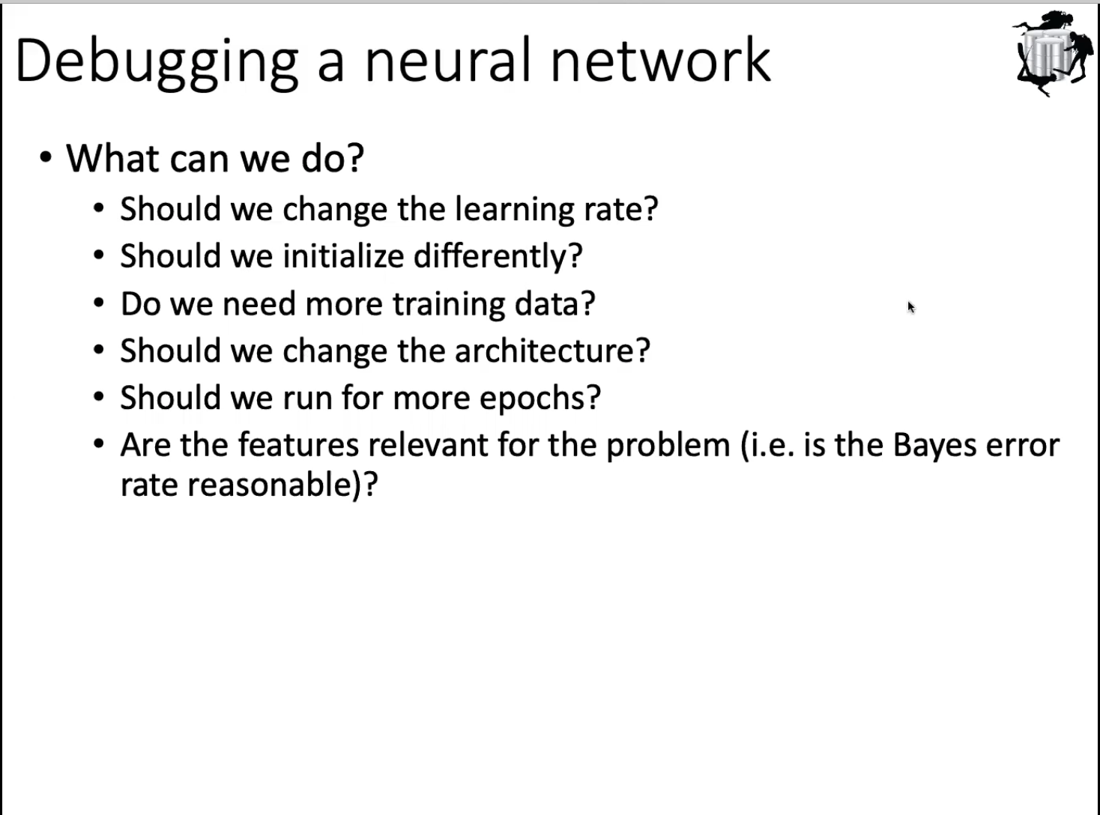
if we initialize by all 0s, neuron may hard to activate, we may use random initialization

Slide 38
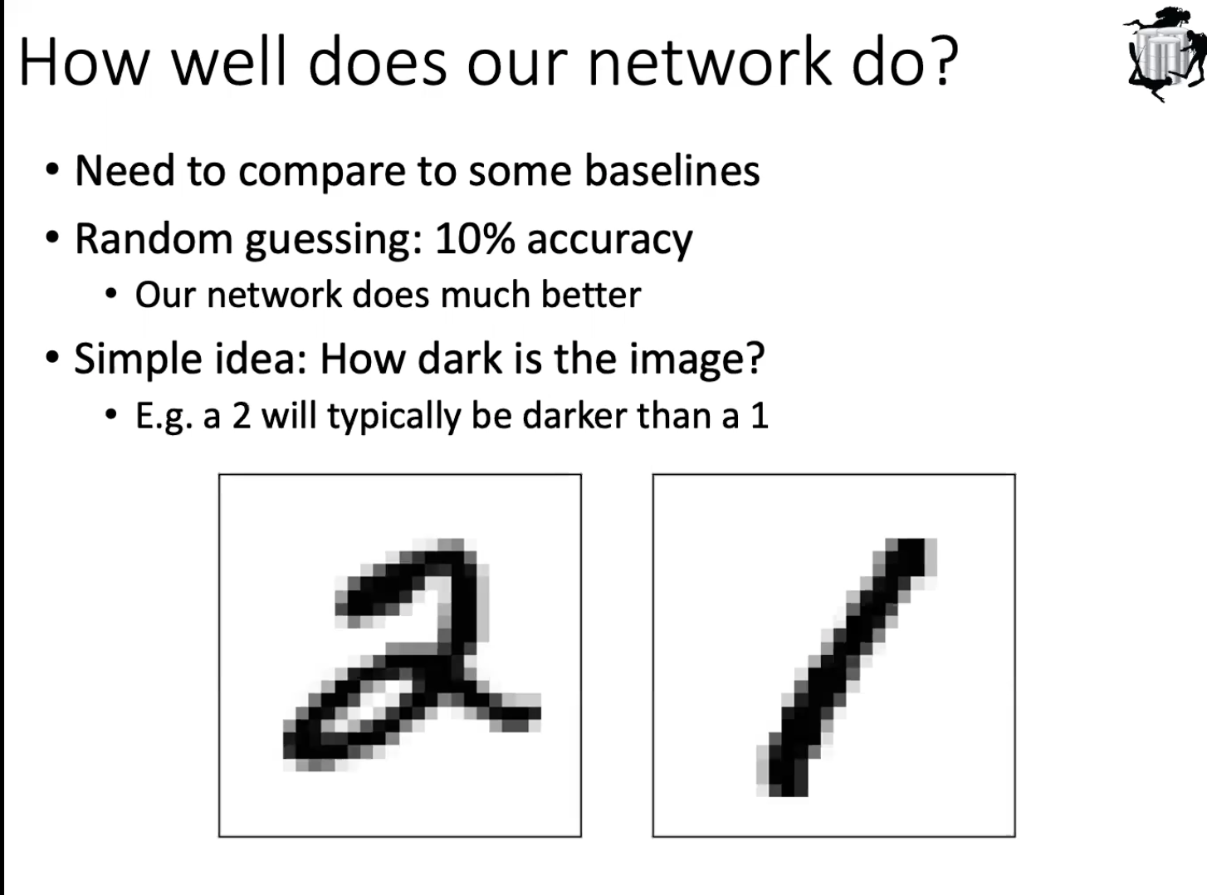

Slide 39
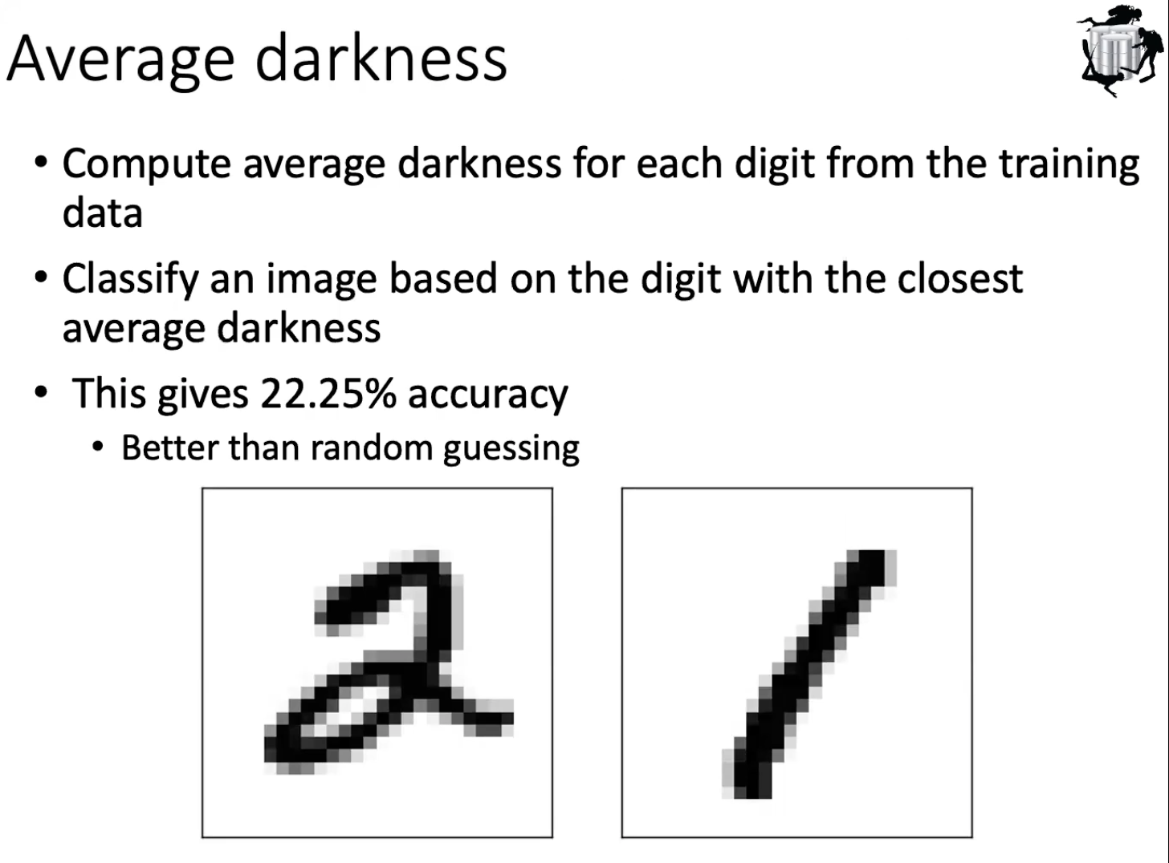

Slide 40

not using neural net

